Slide 1
Drive It Green

Slide 2
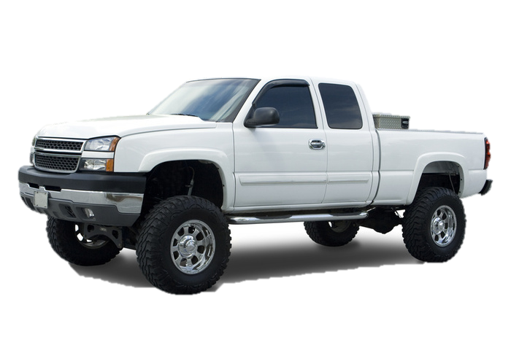
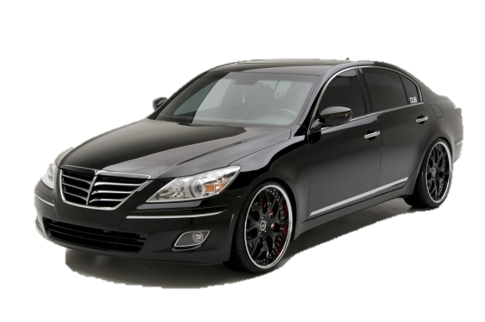
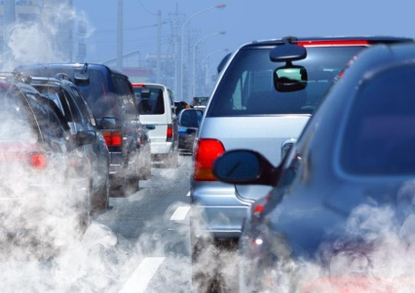
Buying a Car
COLOR
PRICE
SIZE
ENVIRONMENTAL IMPACT
SAFETY
BRAND
FUEL EFFICIENCY

Slide 3
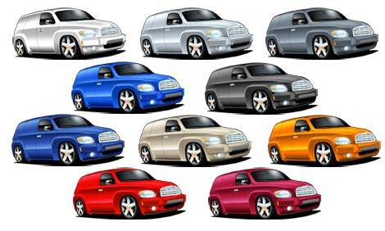
Based on what is most important to you, choose a car.

Slide 4
Car Labels
On your computer, go to www.fueleconomy.gov
Select Find a Car

Slide 5
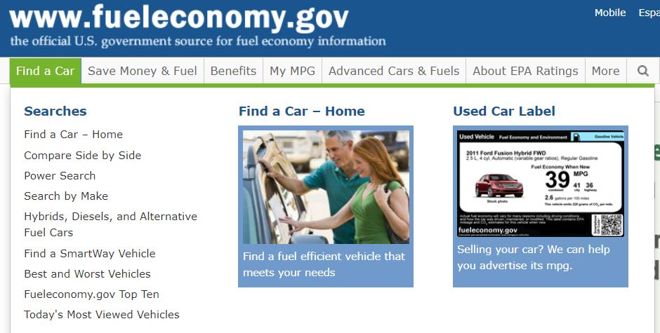
Car Labels
Select Find A Car - Home

Slide 6
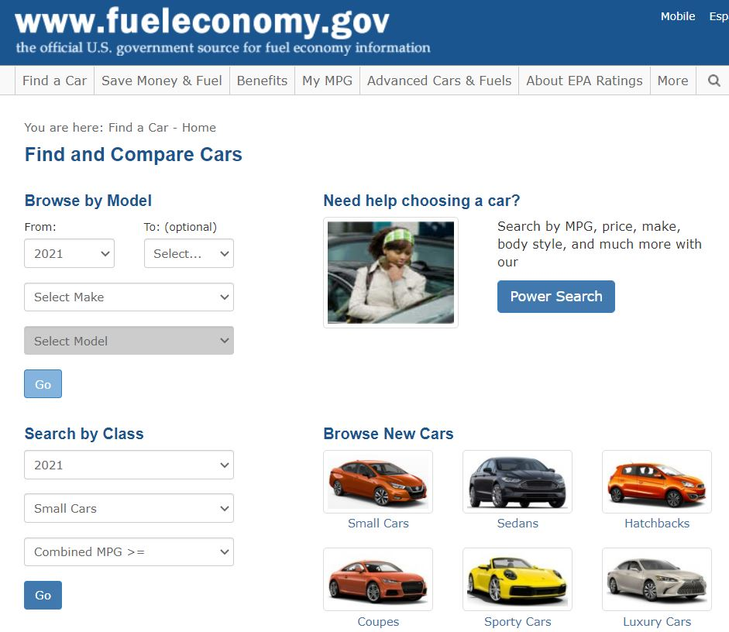
Enter information for the car you chose and
click Go.

Slide 7
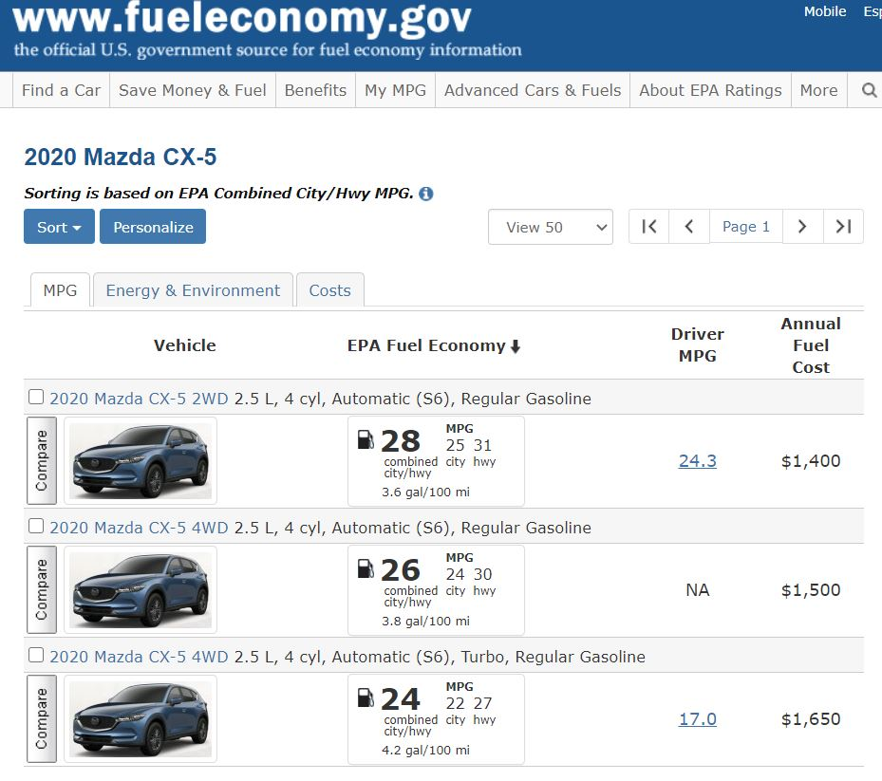
Click here to select your car.

Slide 8
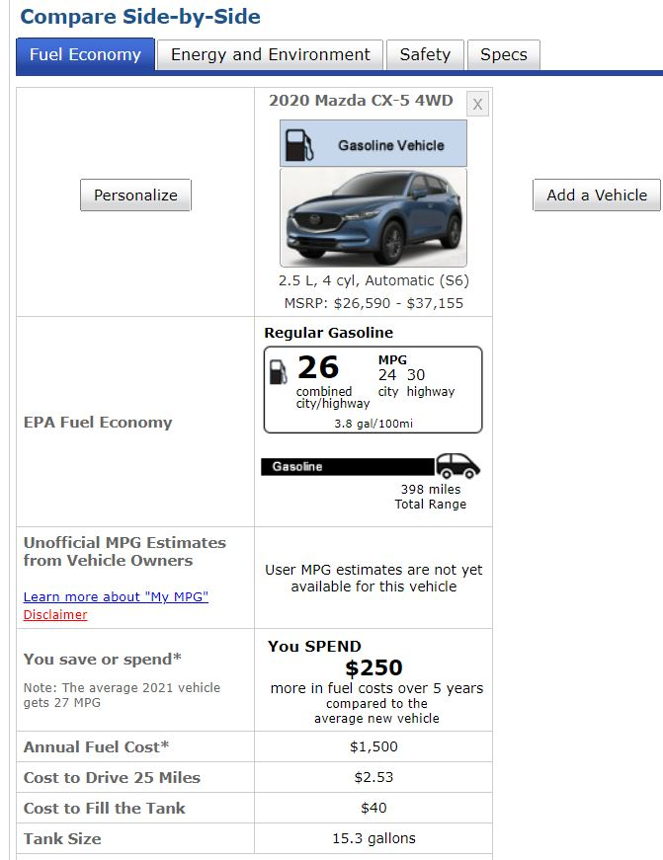
Fuel Economy
Fuel Consumption
Fuel Costs Over 5 years

Slide 9
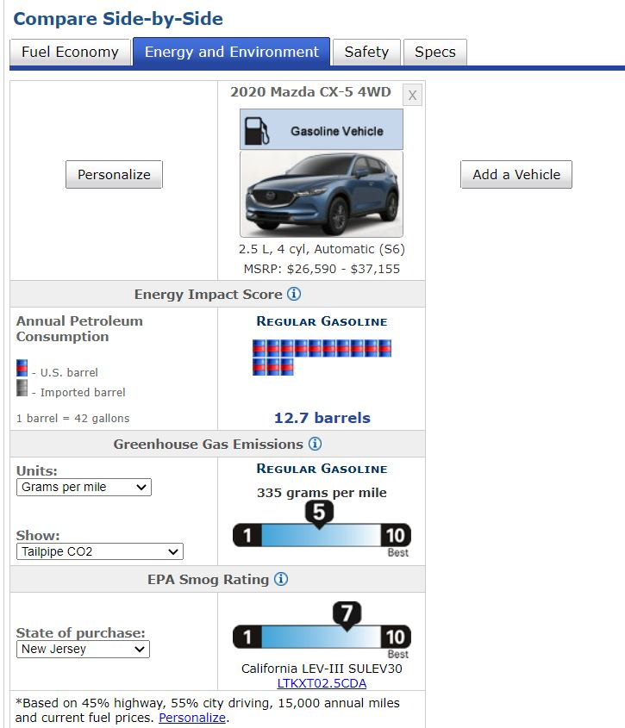
Need to pick New Jersey

Slide 10
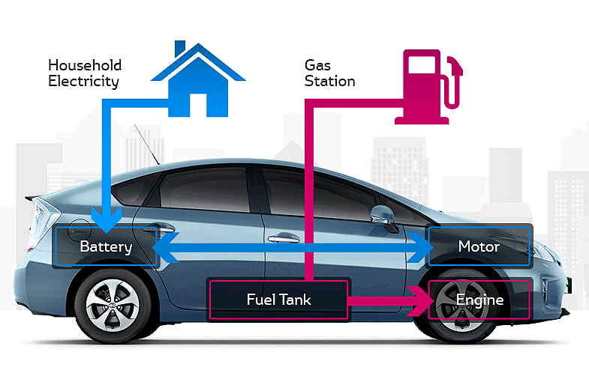
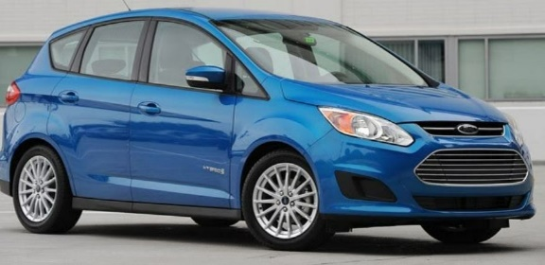
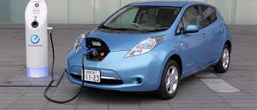
SMALLER SIZE
HYBRID
ELECTRIC
Now, go back and choose another car with better fuel economy.
Then fill out another car label for this car.
Answer the questions on the worksheet.

Slide 11
Discussion
The cars we use affect the environment and the air we breathe.
What can we do to reduce pollution from our cars? What did you observe about your more fuel-efficient car choice?
Electric Vehicle Challenge

